Slide 1
Device Software Market Overview
Martin Klaus
Wind River

Slide 2
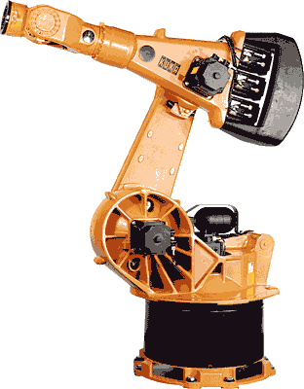
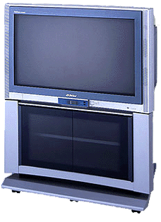
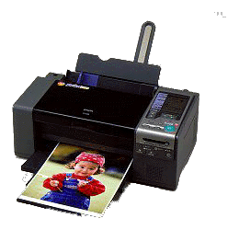
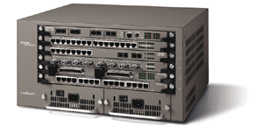
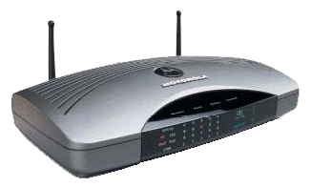


Market Size
Worldwide Shipments
  2004: $905 Million
  2007: $1.5 Billion (20% growth rate)
Key Market Segments
  Consumer Electronics (42%)
  Telecom/Datacom (20%)
  Industrial Automation (14%)
Leading Vendors
  Microsoft (26%)
  Wind River (23%)
Source: VDC July 2005

Slide 3
Market Drivers
Increasing demand for pre-integrated platforms as a basis for standardization enterprise wide
Need for standard development environment regardless of:
  RTOS, Architecture, Programming Language
Focus on building out product offerings through internal development and strategic partnerships
Adoption of Linux forces vendors to focus on addressing the needs of embedded developers
Trend towards commercial OSes from proprietary
Complexity of systems driving towards use of high level design languages (UML) and the adoption of commercial middleware

Slide 4
Device Development Process
Hardware
Bring-Up
Firmware
Driver & BSP
Application
Software
Verification
and Test
Application
Software
Deployment
Verification
and Test
Manufacturing
Enterprise Development Process
Device Development Process
Challenges
  Extremely fragmented solution space
  Increasingly complex hardware and software designs
  Integration of software modules from different sources
  Difficult transition across development phases
  Time, Cost and Quality constraints

Slide 5










Device Software Development Platform
Objective
  Develop frameworks and exemplary tools for device software development to enable hardware bring-up, platform and application software development in a consistent manner
Initial Projects
  Target Management
  Device Debugging
  Mobile Java Tools
Related Projects
  CDT, eSWT, TPTP …

Slide 6
Contacts and Resources
DSDP Website and Mailinglist
  www.eclipse.org/dsdp
  news://news.eclipse.org/eclipse.dsdp
  Doug Gaff, doug.gaff@windriver.com
Embedded Marketing Workgroup
  eclipse.org-embedded-marketing@eclipse.org
  Martin Klaus, martin.klaus@windriver.com
  Robert Day, robert_day@mentor.com
Join the Workgroup!

